Slide 1
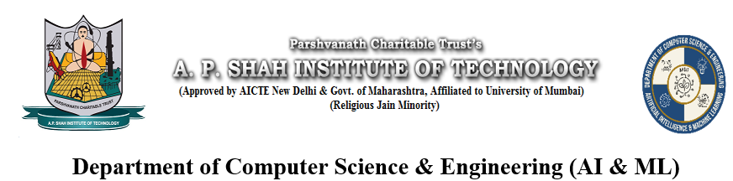
Calorie Tracker Web Application Using Python
Chavez Anthony(22106038)
Sumeet Gupta(22106071)
Mohammed Ali Bardi(22106058)
Kshitij Chitnis(22106078)
Guided by Prof.Shraddha Dalvi

Slide 2
Outline
1.Introduction
2.Literature Survey of The Existing systems
3.Limitations of the existing systems
4.Problem Statement
5.System Design
6.Technologies and Methodologies
7.Implementation
8.Conclusion
9.References

Slide 3

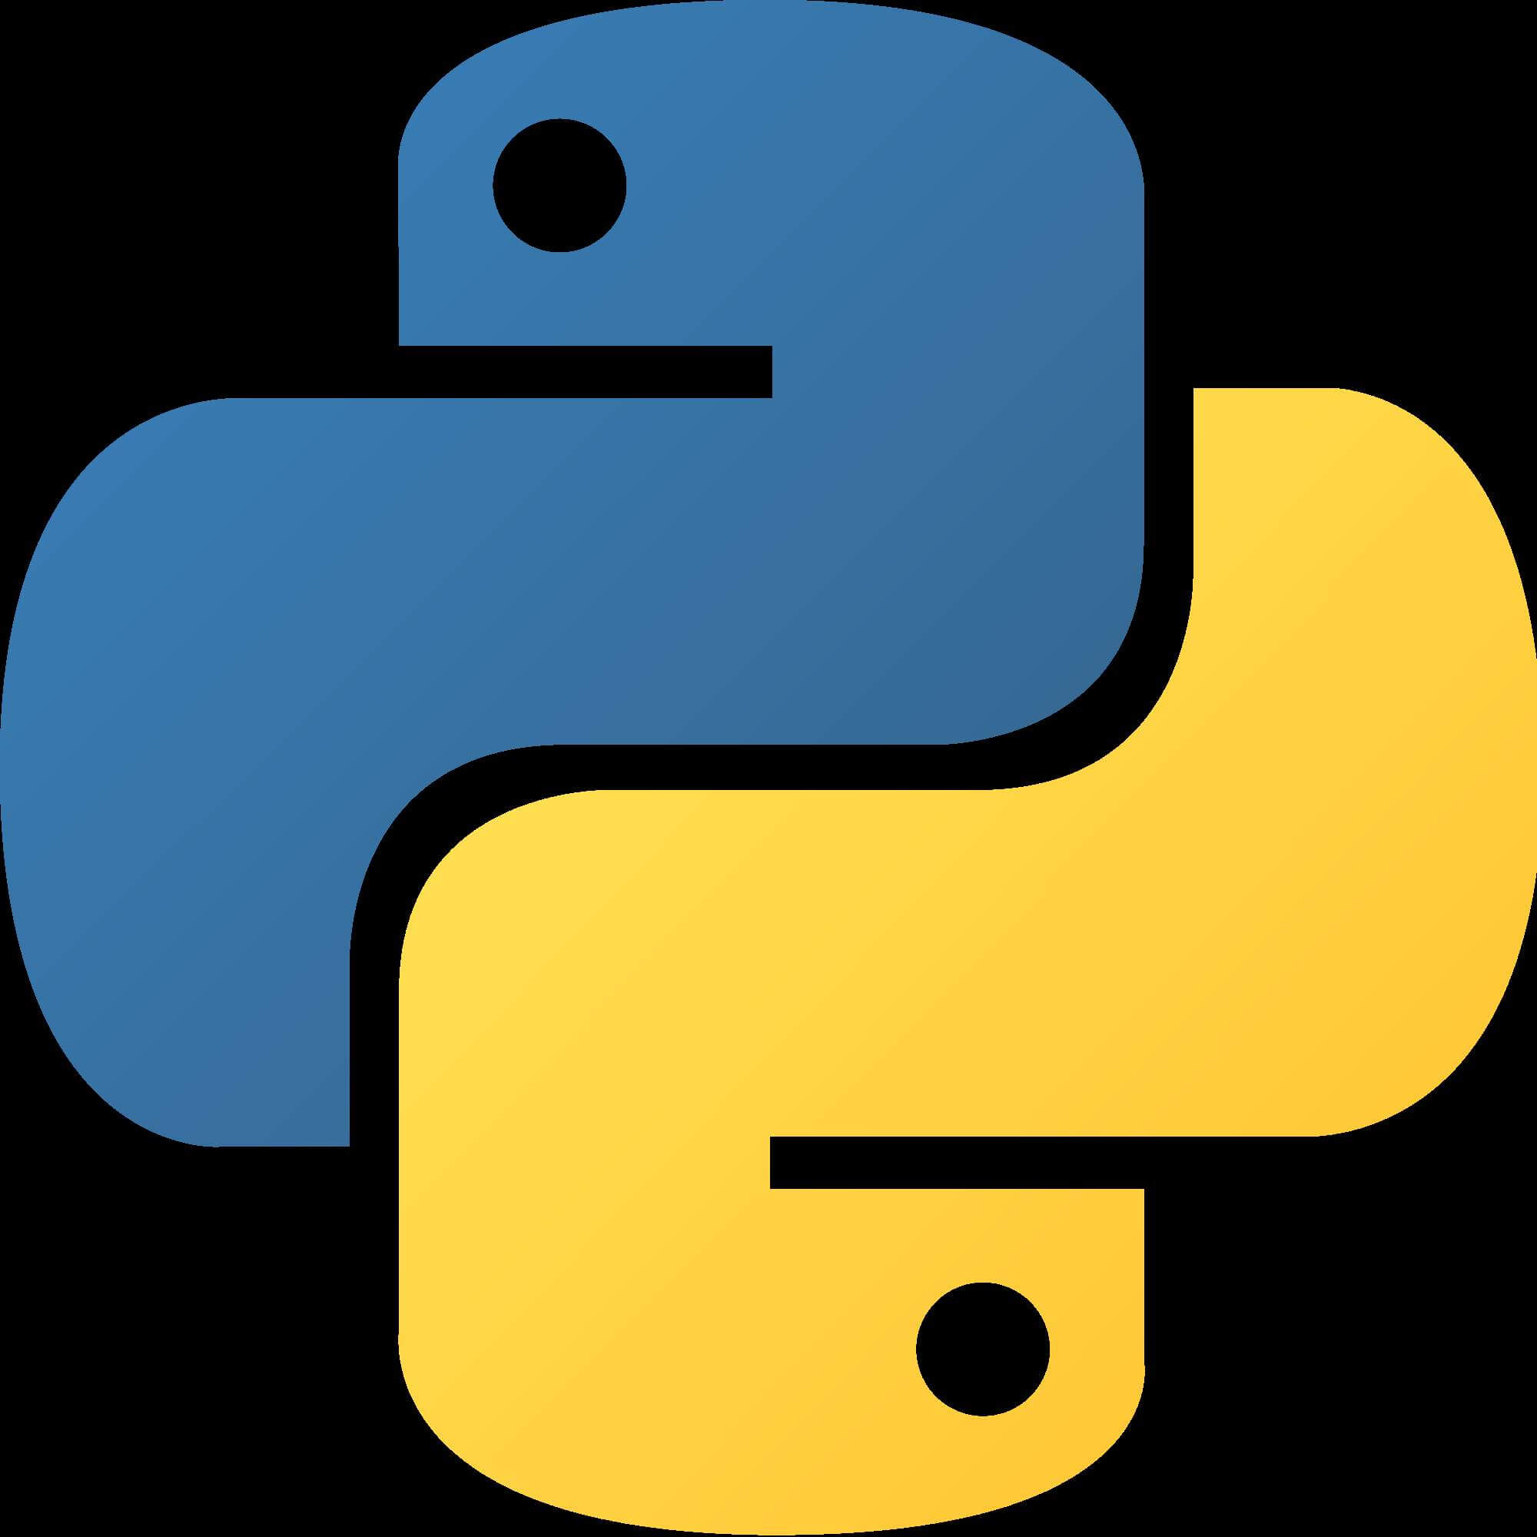
Introduction to the Calorie Tracker Web Application Using Python
The calorie tracker web application is a powerful tool built using djang a high-level Python web framework. It allows users to monitor their daily calorie intake and track their progress. The application provides a user-friendly interface to input meals and snacks, categorize them, and view nutritional information. With a focus on usability and functionality, it aims to simplify the process of managing and maintaining a healthy diet.

Slide 4
Literature survey of the existing system
1.Issues in dietary intake assessment of children and adolescents: dr. M B E Livingstone
There has been a number of proposed methods for measuring daily food diet information. In
this, one existing system which asks the user to give the details of food and drinks he/she had
consumed in 24 hours to the instructor or dietitian but the problem with this type of method is
sometimes people won’t be able to remember exactly what they ate with content and amount.
It is hard for the user to explain and give details of everything he/she consumed in the last 24-
Hours
2. Determination of food portion size by image processing:dr. Mingui Sun
Researchers trying to improve on this technique and in the paper [2] author uses a new idea in
which the user takes a picture of the food before eating and using a calorie card as a reference,
it tells the calorie value of the food. The card should be placed next to the food while
capturing the picture . Drawback of this system is that it will not work without the card.There
is another system which is based on support vector machine but use the thumb for calibration
of each and every food image, it requires long calculation for measuring nutrition of the food
photo taken with the camera of a mobile phone, but the use of thumb of patient for calibration,
solves the problem of carrying cards or special trays. More specifically, a thumb image is
captured and stored with its measurements in the first usage time (first time calibration).
3. Self-monitoring dietary intake: Current and future practices:dr. Lora E Burke
In this, another method had been proposed by the author where a user have the PDA(personal
diet assistant) app. In which the user record the daily food intake information on a mobile
phone . but it has been shown that result of the portion has significant error and take long time
for the user to enter the record.

Slide 5
Limitations of the existing systems
1.Inaccuracies in Food Databases: Calorie tracker systems rely on extensive food databases for estimating the nutritional content of foods. However, these databases may not always be comprehensive or up-to-date, leading to inaccuracies in calorie and nutrient calculations.
2.Portion Size Estimation: Users often struggle with accurately estimating portion sizes, which can affect the accuracy of calorie tracking. This is particularly challenging when consuming meals outside of controlled settings, such as restaurants or social gatherings.
3.Limited Food Recognition: While some calorie tracker apps offer features like barcode scanning and photo recognition, they may not accurately identify all foods or dishes, especially homemade or culturally diverse meals.
4.Variability in Nutrient Absorption: Calorie tracker systems typically provide estimates based on average nutrient absorption rates. However, individual differences in metabolism, gut microbiota, and other physiological factors can lead to variations in nutrient absorption and utilization, impacting the accuracy of calorie tracking.

Slide 6
Problem Statement
Despite the growing popularity of calorie tracking apps and tools for managing dietary intake, several challenges persist in their effectiveness and user adoption. Current calorie tracker systems face limitations in accuracy, user engagement, and long-term adherence, leading to suboptimal outcomes in weight management and overall health improvement. These limitations include inaccuracies in food databases, challenges in portion size estimation, user compliance issues, and privacy concerns surrounding data collection and sharing. Moreover, existing systems often lack personalized guidance and fail to consider individual dietary preferences, cultural practices, and lifestyle factors..
By addressing these challenges, the next generation of calorie tracker systems can empower users to make informed dietary choices, achieve their health and fitness objectives, and sustain long-term behavior change for improved health outcomes.

Slide 7
System Design
start
User inputs age, and weight
Tracking of weight and displaying on line graph
User inputs food intake
Consumed calories is calculated and macro distribution is shown
Intake calories is subtracted from goal calories
If result > 0
no
yes
Diet plan suggestion
Workout suggestion
end

Slide 8
Technologies and Methodologies
Here's an overview of the key components and steps involved:
Django: Django is a high-level Python web framework that facilitates rapid development and clean, pragmatic design. It provides built-in features for handling web requests, managing databases, and rendering templates.
HTML: HTML (HyperText Markup Language) is the standard markup language for creating web pages. It provides the structure and content of the calorie tracker interface.
Bootstrap: Bootstrap is a popular front-end framework for building responsive and mobile-first websites. It offers pre-designed templates, CSS components, and JavaScript plugins to streamline the development process and ensure consistency across different devices.
Database: Django supports various databases, including SQLite (for development), PostgreSQL, MySQL, and Oracle. We chose postgresql.

Slide 9
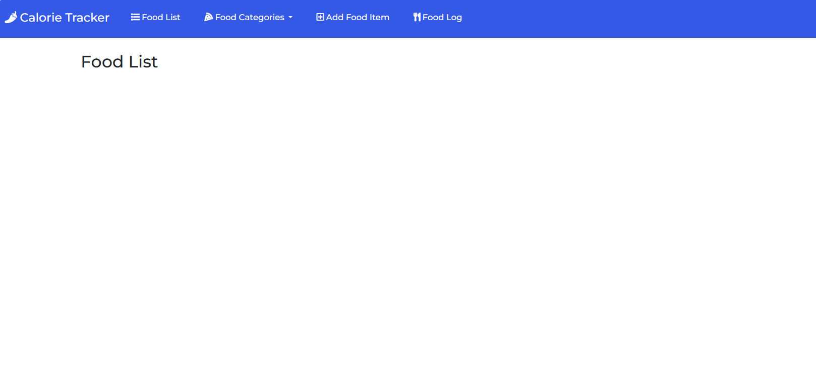
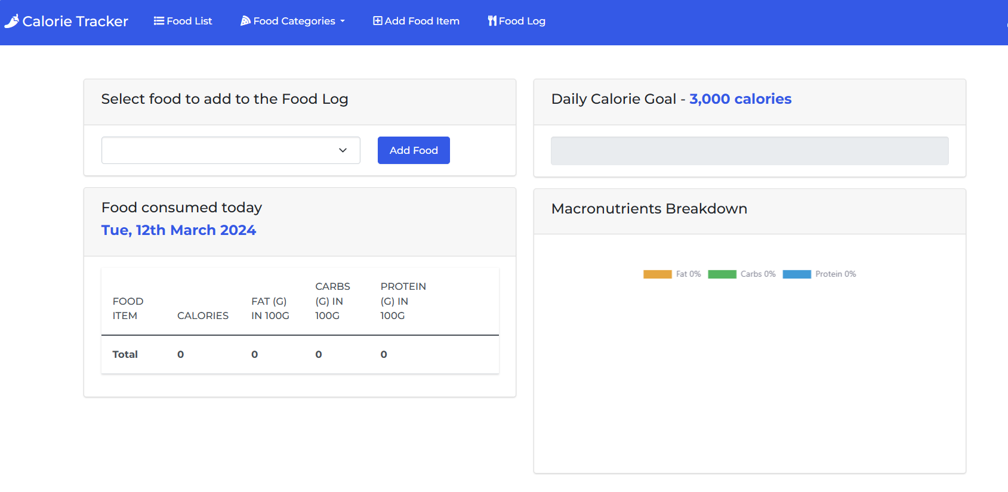
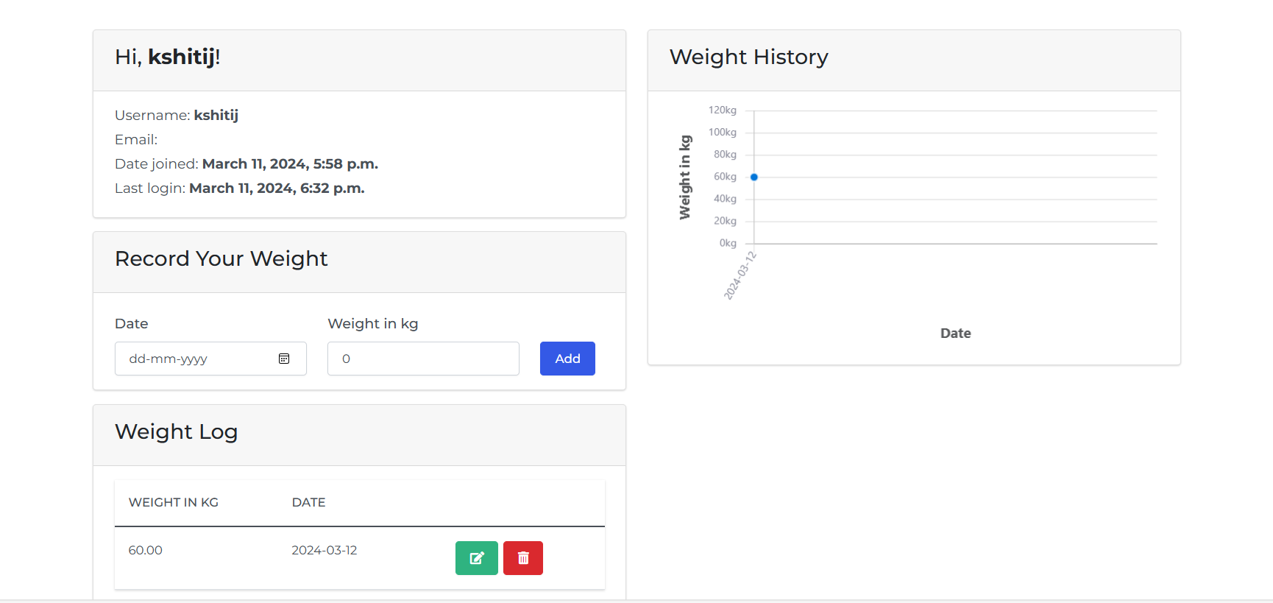
Implementation

Slide 10
References
Issues in dietary intake assessment of children and adolescents - PubMed (nih.gov)
Determination of food portion size by image processing | IEEE Conference Publication | IEEE Xplore
Self-monitoring dietary intake: current and future practices - PubMed (nih.gov)

Slide 11
Conclusion
In conclusion, the calorie tracker project stands at the intersection of technological innovation and health awareness.

Slide 12
THANK YOU

